Slide 1
Chapter 9: Class and Method Design
Stefan Bund
College of Business Administration
Division of Computer Information Systems
CIS 315

Slide 2
Learning Progress
Chapter 1 Intro to System Analysis and Design
Part One
Chapter 2 Project Initiation
Chapter 3 Project Management
Chapter 4 Requirements Determination
Part Two Analysis Modeling
Chapter 5 Functional Modeling
Chapter 6 Structural Modeling
Chapter 7 Behavioral Modeling
Part Three Design Modeling
Chapter 8 Moving on to Design
Chapter 9 Class and Method Design
Chapter 10 Data Management Layer Design
Chapter 11 Human-Computer Interaction Layer Design
Part Four Design Patterns

Slide 3
Why Detailed Design is Important
Why Detailed Design is important?
With today’s modern CASE tools, quite a bit of the actual code can be generated by the tool from the detailed design.
Even preexisting classes and components needs to be understood, organized, and pieced together.
It is still common for the project team to have to write some code and produce original classes that support the application logic of the system.
What if one jumps right into coding without it?
The use of layers can simplify the individual classes, they can increase the complexity of the interactions between them.
The classes are not designed carefully, the resulting system can be very inefﬁcient.
The instances of the classes (i.e., the objects) will not be capable of communicating with each other, which will result in the system not working properly.

Slide 4
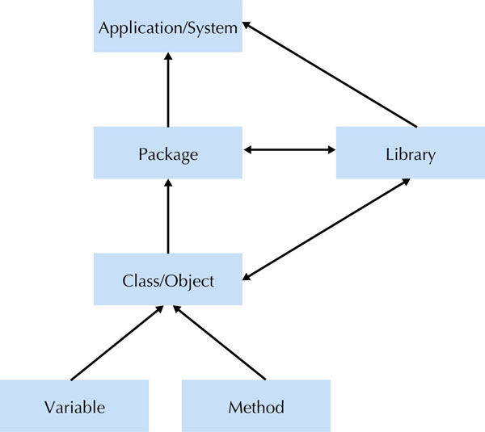
Levels of Abstraction in Object-Oriented Systems
In an object-oriented system, changes can take place at different levels of abstraction.
So changes made to reusable class libraries and off-the-shelf can turn out to be a significant amount of work, making it necessary to do low-level, or detailed design.

Slide 5
Basic Characteristics of Object Orientation - Encapsulation, Inheritance and Polymorphism

Slide 6
Elements of OOSAD
Classes
Templates used to define data and process that each object contains
Objects
Instances of classes
Attributes (also called fields)
Describe data about the object
States
Value of the object’s attributes and its relationship with other objects at a particular point in time
Methods
Describe processes the object can perform
Messages
Basically function calls

Slide 7
A Class Diagram for the Product class

Slide 8
Encapsulation & Info Hiding
Encapsulation
The mechanism that the class combines the data and processes into a single object and controls their accessibility by other objects.
Information Hiding
Only the information required to use an object be available outside the object;
Relates to the visibility of an object’s attributes and methods;
The only communication between objects should be through an object’s methods.(attributes are usually private) and messages/function calls to trigger them.
Exactly how the object stores data or performs methods is not relevant, as long as the object functions correctly.
Key to reusability
it shields the internal workings of the object from changes in the outside system, and it keeps the system from being affected when changes are made to an object.

Slide 9
Class Diagrams for Product Maintenance App
Superclass →
Subclass →
← Subclass
Inherited →
← Inherited
New →
← New
Superclasses are more generic, containing common elements of related subclasses.
If you need separate classes to represent distinct types of products, you can create a Product superclass, then create a separate subclass for each type of product that inherits the Product class.

Slide 10
Inheritance
Inheritance let you creates a new class based on an existing class. The new class inherits the fields, constructors, and methods of the existing class.
A subclass can extend the superclass by adding new fields, constructors, and methods to the superclass. It can also override a method from the superclass with its own version of the method.
To create a new window (called a frame in Java), you can code a class that inherits the JFrame class that’s in the javax.swing package. You then can add frame, and add controls to the frame, and extend the frame by by coding new fields and methods.

Slide 11
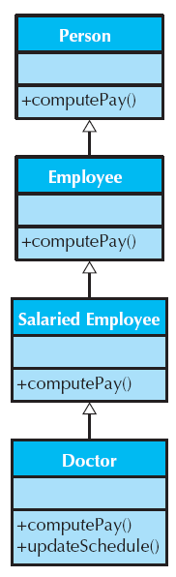
Another Inheritance Example
Single inheritance – a subclass inherit from one super class.
Multiple inheritance - a subclass may inherit from more than one superclass. Inheritance conflicts can multiply.
It is important at this point in the development of the system to know what the chosen programming language supports.

Slide 14
← Think about what should go here in the Software subclass?

Slide 17
Polymorphism & Dynamic Binding
Polymorphism is a feature of inheritance that lets you treat objects of different subclasses that are derived from the same superclass as if they had the type of the superclass.
For example, Book is a subclass of Product, you can treat a Book object as if it were a Product object.
If you access a method of a superclass object and the same method is overridden in the subclasses of that class, polymorphism determines which specific method is executed based on the object’s type at run time (i.e. dynamic binding). In other words, same message triggers different methods in different objects.
For example, if you call the toString() method of a Product object, the toString method of the Book class is executed if the object is a Book object.
On using polymorphism
Most object-oriented programming languages support dynamic binding of methods, and some support dynamic binding of attributes. It is important to know what object-oriented programming language is going to be used (i.e., Language speciﬁc).
The key to controlling the difficulty of understanding object-oriented systems when using polymorphism is to ensure that all methods with the same name implement that same generic operation (i.e., they are semantically consistent).

Slide 18
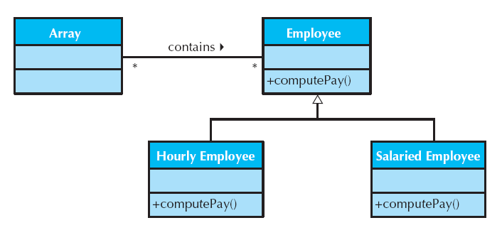
Another Polymorphism Example

Slide 19
Design Criteria

Slide 20
What is a Good Design
A good design is one that balances trade-offs to minimize the total cost of the system over its entire lifetime.
Criteria to determine a good design:
coupling
cohesion
connascence

Slide 21
Coupling
Coupling refers to how interdependent or interrelated the modules (classes, objects, and methods) are in a system.
The higher the interdependency, the more likely changes in part of a design can cause changes to be required in other parts of the design.
Two types of coupling in object-oriented systems:
Interaction coupling through message passing
In general, interaction coupling should be minimized.
Except non-problem-domain classes (e.g., report) must be coupled to their corresponding problem-domain classes (e.g. employee)
Inheritance coupling dealing with how tightly coupled the classes are in an inheritance hierarchy.
Mostly desired.
The best way to solve this conundrum is to ensure that inheritance is used only to support generalization/specialization (a-kind-of) semantics and the principle of substitutability.

Slide 22
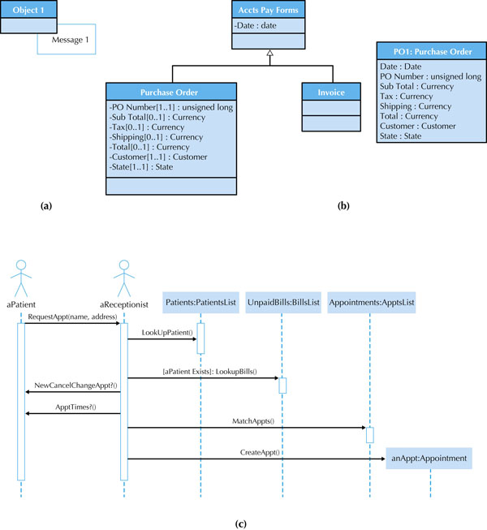
Should send messages only to one of the following:
Itself (For example, in Figure 9-6a, Object1 can send Message1 to itself.)
An object that is contained in an attribute of the object or one of its superclasse. (For example in Figure 9-6b, PO1 should be able to send messages using both its Customer and Date attributes.)
An object that is passed as a parameter to the method (For example in Figure 9-6c, the aPatient instance sends the message RequestAppt(name, address) to the aReceptionist instance, which is allowed to send messages to the instances contained in the name and address parameters.)
An object that is created by the method (For example in Figure 9-6c, the method RequestAppt associated with the aReceptionist instance creates an instance of the Appointment class. As such, the RequestAppt method is allowed to send messages to anAppt.)
An object that is stored in a global variable.
Figure 9-6: Interaction Coupling Examples

Slide 23
Law of Demeter
Messages should be sent only by an object:
to itself
to objects contained in attributes of itself or a superclass
to an object that is passed as a parameter to the method
to an object that is created by the method
to an object that is stored in a global variable

Slide 24
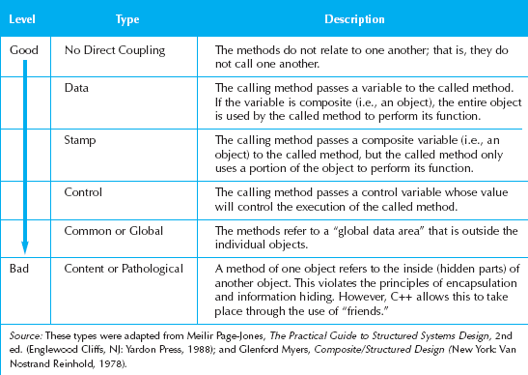
Types of Interactive Coupling

Slide 25
Cohesion
Cohesion refers to how single-minded a module (class, object, or method) is within a system.
A class or object should represent only one thing, and a method should solve only a single task.
Three general types of cohesion:
Method cohesion
Class cohesion
Generalization/specialization cohesion

Slide 26
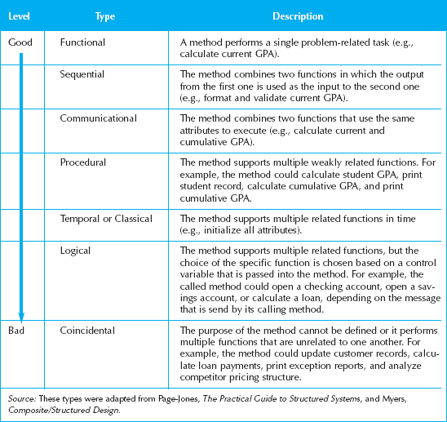
Types of Method Cohesion

Slide 27
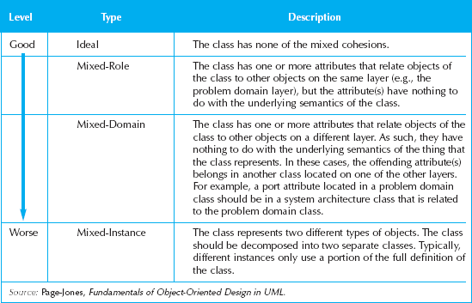
Types of Class Cohesion
A cohesive class should have these attributes (Glenford Meyers):
It should contain multiple methods that are visible outside the class (i.e., a single-method class rarely makes sense).
Each visible method performs only a single function (i.e., it has functional cohesion).
All methods reference only attributes or other methods defined within the class or one of its superclasses.
It should not have any control-ﬂow couplings between its visible methods.

Slide 28
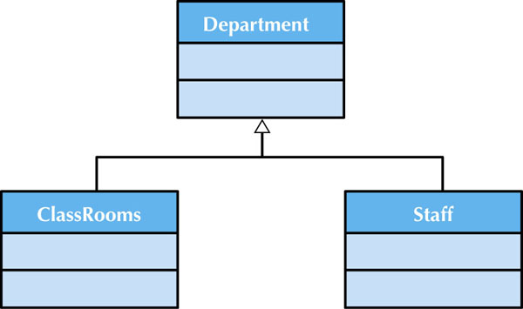
Generalization/Specialization Cohesion
Focus on the type of relationship (association, aggregation, or membership) between classes.
Highly cohesive inheritance hierarchies should support only the semantics of generalization and specialization (a-kind-of) and the principle of substitutability.
Instances of the ClassRooms and Staff classes are not a-kind-of Department, but a part-of.
However, in the early days of object-oriented programming, this use of inheritance was quite common. When a programmer saw that there were some erties that a set of classes shared, the programmer would create an artiﬁcial abstraction that deﬁned the commonalities.
This was potentially useful in a reuse sense, but it turned out to cause many maintenance nightmares.

Slide 29
Connascence
Connascence literally means “to be born together.”
From an object-oriented design perspective, it really means that two modules (classes or methods) are so intertwined that if you make a change in one, it is likely that a change in the other will be required.
In practice we want to:
Minimize overall connascence
Minimize across encapsulation boundaries
Maximize within encapsulation boundary

Slide 30
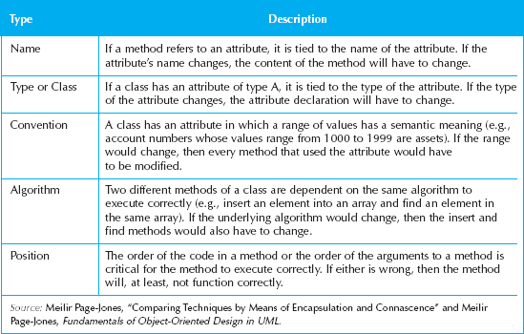
Types of Connascence

Slide 31
Object Design Activities

Slide 32
Additional Specification
First review the current set of models
Sufficient but only necessary classes to solve problem
No missing attributes or methods
No extra or unused attributes or methods
Finalize visibility of attributes and methods in each class
In SmallTalk, attributes are private and methods are public by default.
in C++ and Java, you can set the visibility to private (hidden), public (visible),or protected (visible to subclasses, but not to other classes).
Decide on signature of every method in each class
Name of the method, parameters/arguments including their object types, and object type of the return value

Slide 33
Additional Specification (Contd.)
Define any constraints that must be preserved by the objects
E.g. an attribute of an object that can have values only in a certain range.
3 Types of constraints captured in form of contracts (described later in this chapter)
Pre-conditions
Post conditions
Invariants
How to handle violations
i.e., exceptions in C++ and Java

Slide 34
Identify Opportunities for Reuse
Design Patterns
simply useful grouping of collaborating classes that provide a solution to a commonly occurring problem.
Framework
a set of implemented classes that can be reused as a basis for implementing an application. Tend to be more domain specific.
Used to develop objects on system architecture, HCI, or data management layers
E.g. Java Spring for enterprise software, Magento for eCommerce (PHP)
Class libraries
Similar to framework but not domain specific. Java libraries.
Used to develop frameworks and components, support the foundation layer
Components
A component is a self-contained, encapsulated piece of software that can be plugged into a system to provide a speciﬁc set of required functionalities. E.g. ActiveX, Java Bean
Used to simplify the development of objects on problem-domain and HCI layers.

Slide 35
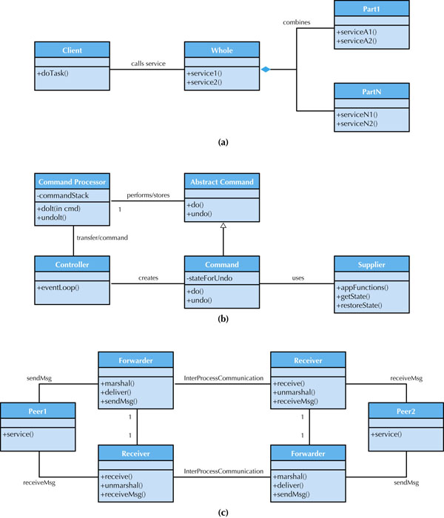
Design Pattern that supports aggregation and composition relationship
Design Pattern that separates interface from operation by control process
Design pattern that supports peer-to-peer physical architecture

Slide 36
Restructure the Design
Factoring
the process of separating out the aspects of a method or class into new ones to simply overall design
Map design to current language
Normalization (More in Chapter 10)
Assure all inheritance relationships support only generalization/specialization semantics

Slide 37
Optimizing the Design
Review access paths
Review attributes of each class
Review direct and indirect fan-out
Number of messages sent by the method itself (direct) or other methods (indirect)
Consider execution order of statements in often-used methods
Avoid re-computation by creating derived attributes and triggers

Slide 38
Constraints and Contracts

Slide 39
Types of Constraints
Precondition
Must be true before the method executes
For example,the parameters passed to a method must be valid for the method to execute. Otherwise, an exception should be raised.
Post-condition
Must be true after the method finishes
For example, the method can not make any of the attributes of the object take on an invalid value. In this case, an exception should be raised, and the effect of the method’s execution should be undone.
Invariant
Must always be true for all instances of the object

Slide 40
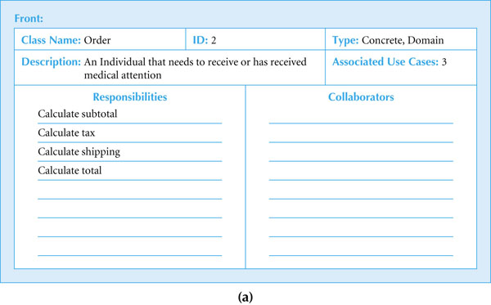
CRC Card (Front) for Order Class

Slide 41
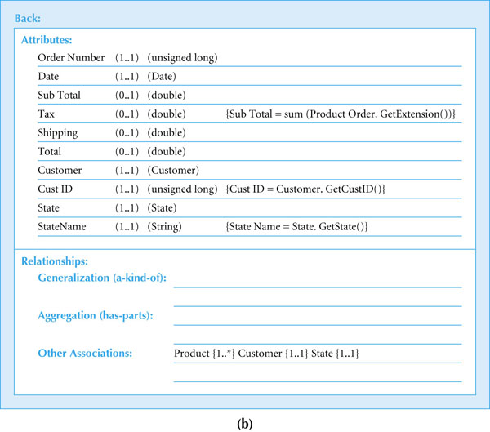
Invariants on CRC Card (Back) for Order Class

Slide 42
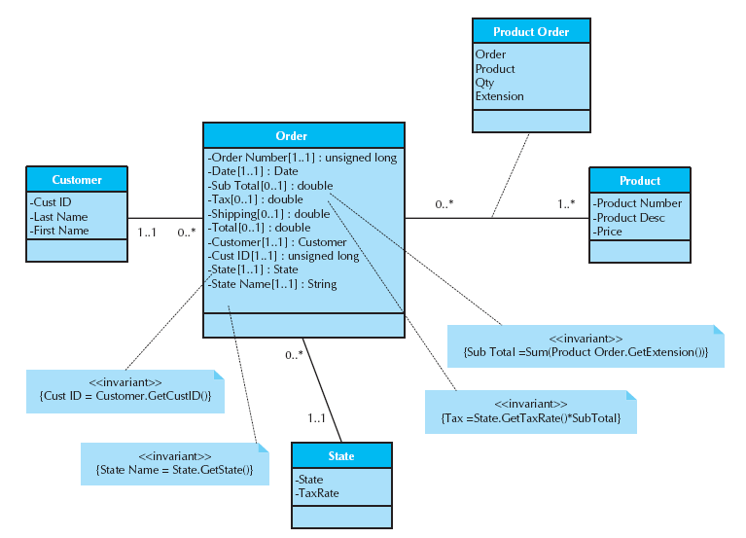
Invariants on a Class Diagram
Additional invariants were added to four of the attributes. For example, Cust ID must not only be an unsigned long, but it also must have one and only one value [i.e., a multiplicity of (1..1)], and it must have the same value as the result of the GetCustID() message sent to the instance of Customer stored in the Customer attribute. Also shown is the constraint for an instance to exist, an instance of the Customer class, an instance of the State class, and at least one instance of the Product class must be associated with the Order object.

Slide 43
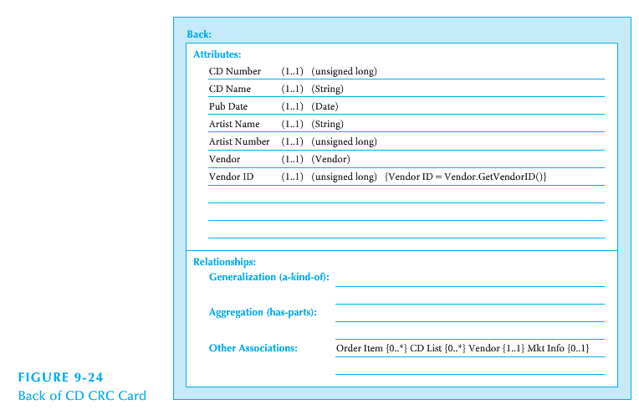
CD Selection Case Study

Slide 44
Contracts
Contracts document message passing between object
A contract is created for each method that is publicly visible in a class
Should contain enough information for the programmer to understand what the method is supposed to do

Slide 45
Elements of a Contract
Method name
Class name
ID number
Client objects
Associated use cases
Description
Arguments received
Type of data returned
Preconditions
Post-conditions

Slide 46
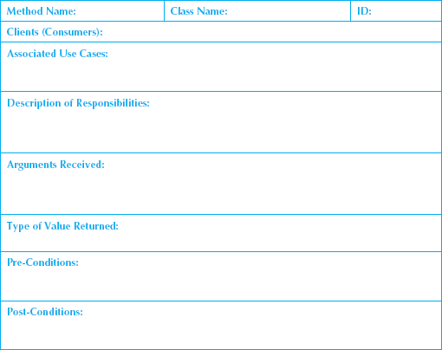
Sample Contract Form

Slide 47
Method Specification

Slide 48
Method Specification Syntax
No formal syntax specification
General information
Events
Message Passing
Algorithm Specification

Slide 49
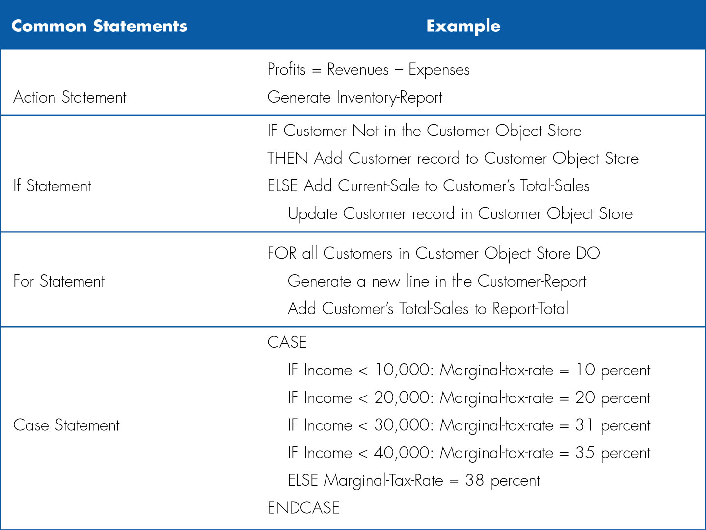
Structured English

Slide 50
Pseudocode Example
(Get CD-info module)
Accept (CD_title) {Required}
Accept (CD_artist) {Required}
Accept (CD_category) {Required}
Accept (CD_length)
Return

Slide 51
Summary
Basic Characteristics of Object Orientation
encapsulation, inheritance, polymorphism
Design Criteria
coupling, cohesion, and connascence
Object Design Activities
Specify, restructure, and optimize object designs.
Identify the reuse of predefined classes, libraries, frameworks, and components.
Constraints and Contracts
Method Specification

